Slide 1

A Deeper Insight Into Taxation :
An Economic Approach

Slide 2
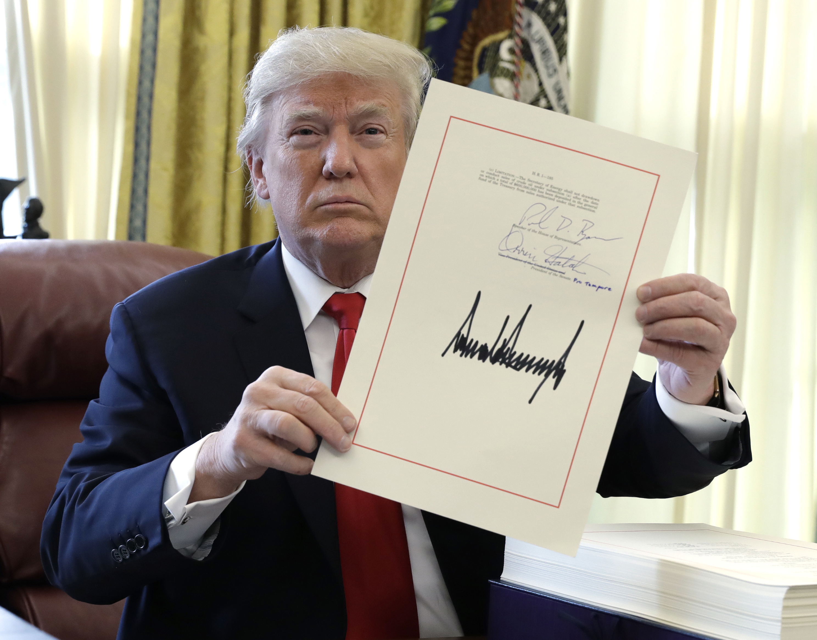

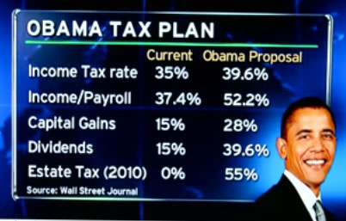
Notes:
The issue of tax cuts is an incredibly controversial topic in the US today. There has been the Trump tax deduction that was put in place recently has caused even more controversy than usual because people worry that it will create a larger deficit and that the rich will not have to pay their fair share.
However on this presentation. I will argue that low taxes are an essential requirement for the country to progress because wealth does not just happen it needs to be produced.
I will argue that there is substantial evidence that can prove that when economic liberty is increased in a country in the form of a tax deduction, there is usually more economic progress in that area. This trend of economic progress in the US will continue with the recent tax reform by Trump.

Slide 3


Arguments in favor of lower taxes
Notes:
High taxes cause a frustration in the individual who may feel that the social mobility ladder is just a myth. There was a clear stagnation in wages during the Obama administration. There was a clear stagnation of middle-class wages and in some cases even a decline in middle-class wealth. Even though the tax increase created more public services, like Obamacare and other noble and charitable governmental causes, there was a clear dissatisfaction expressed by the average American.
Investment growth: The health and growth of a national economy depends on the driving force of tax reductions for several reasons. First, tax reductions increase the incentive to invest. A lower corporate tax rate gives investors in a new factory a larger share of the income that factory generates. In turn, more investment project to pass the cost-benefit test that informs a company whether the project is a worthy investment in the first place. A company will not invest in building a factory if the benefit does not outweigh the cost. This also imolies that less jobs are going to be created and better quality jobs are created

Slide 4


Moral Arguments
Notes:
Tax cuts are also good for the people for moral reasons. Boaz explains, “In a free country, money belongs to the people who earn it” (Boaz, 2001). The government has no moral right to rob its citizens of the money they rightfully earned for themselves. If people are continually forced to relinquish the money that they rightfully earned to the government , they will only grow more and more frustrated and bitter. The bottomline of this is that the government has no right to steal from its citizens, and freedom should be prioritize over equality

Slide 5

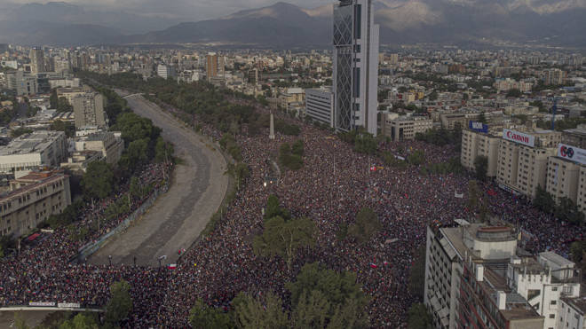
Arguments in favor of high taxes
Notes:
When the difference in wealth is not so big it generates a healthier, more solid, and more peaceful society. Inequality generates a bigger social disintegration and more conflict between different economic classes. The bottomline is that whe n rich people are cery rich and poor people are very poor there will be social catastrophe.

Slide 6


Notes:
More Revenue
The final argument for increasing taxation is that the government is going to raise more revenue. Raising more revenue is good because with the extra revenue that the government raises they can distribute more to each area in change of government (i.e education, infrastructure, security etc.) or focalize more revenue in a particular area in which that country has the most problems .

Slide 7
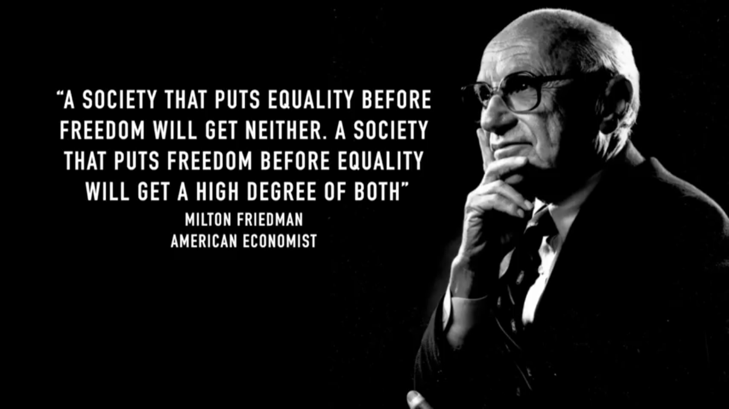

Rebuttal
Notes:
With the pie analogy, there is a rebuttal to the revenue for public works and redistribution

Slide 8
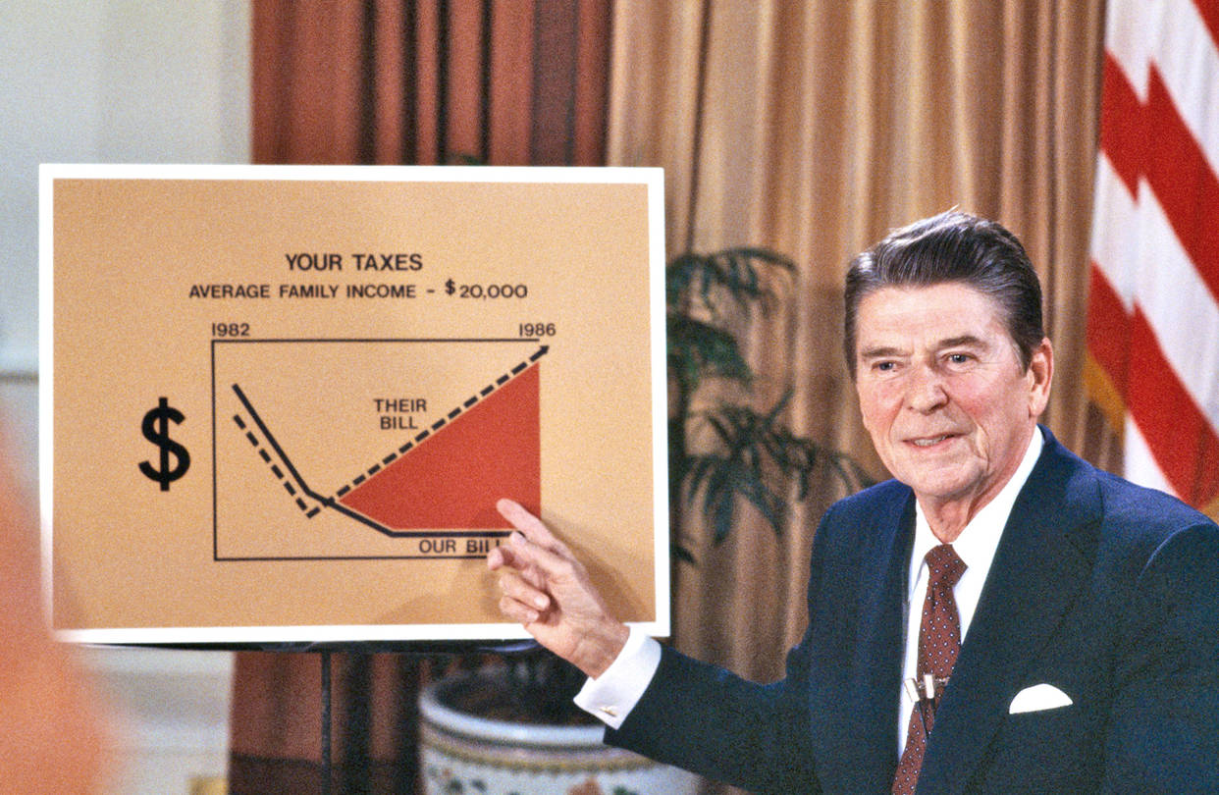

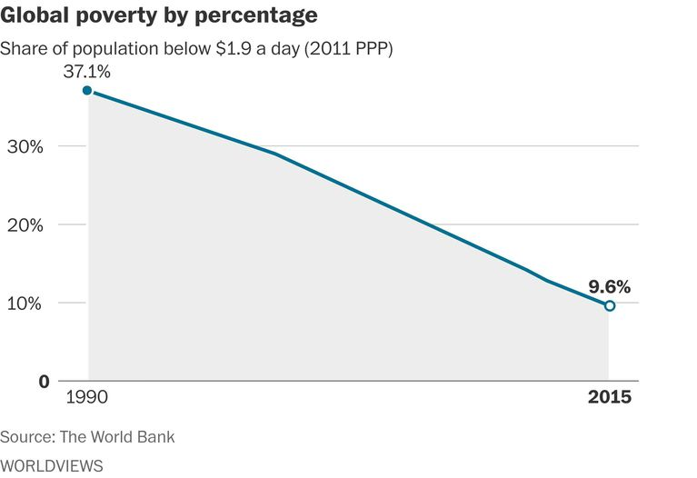
Closing Remarks
Notes:
Closing Remark of US and Switzerland vs Cuba
At first glance the arguments of the left of reducing inequality and raising more revenue can be appealing, however, it is better to have a better functioning society with higher inequality but greater prosperity in the long run. The empirical and scientific evidence available tends to show higher GDP growth rates and less poverty

Slide 9


